Slide 1
Aller Loin
Prepared by:
Ibrahim Al Sebaai
Mohamed Bassel Itani
Hicham Nehme

Slide 2
Table of content
Introduction
Aim
User Analysis
Users
Tasks Analysis
Implementation
Tutorial
Design
Future Work
Conclusion

Slide 3
1. Introduction
When people are given the chance to travel or even to get information about a country they hope to visit someday, they ask them self “Where should I go?” Choosing a country to visit is not an easy task, the traveler should check a lot of information about a selected country , including hotels , restaurants , cities , airports, natural attractions and landscapes, and the culture of this country. For this reason we’ve created “Aller Loin”.

Slide 4
1.1 Aim
The aim of “Aller Loin”, is to guide and direct the user to countries that he/she hopes to visit or take sufficient information about said country, and check user reviews, opinions, and photos of hotels, restaurants, attractions, and more…More so, we aimed at keeping the application simple, ergonomic, and easy to use, so that people of all ages can feel comfortable using Aller Loin.
In conclusion we can say that we’ve created “Aller Loin” to help people browse/surf countries around the world.

Slide 5
2. User Analysis
User Form
About: Search and browse countries.
Users: Travelers People who are interested about a certain country Typical user Potential overseas students
Most used by: Travelers
Application similar to Aller Loin: Trip Advisor (http://www.tripadvisor.com) TouristEye (http://www.touristeye.com)

Slide 6
2.1 Users
Travelers:
This kind of user is lost about where to go next, and need help being directed and guided.
People who are interested about a certain country:
This kind of user is not sure if he/she wants to travel or not, so he/she seek guidance and direction about countries and this may lead him/her to traveling someday.
Typical user:
This kind of user is not interested about traveling but he/she wants to get an idea or two about countries or the application.
Potential overseas students:
This kind of users is interested about studying abroad, so they seek guidance about universities in different countries.

Slide 7
3. Tasks Analysis:
In this part we will talk about our tasks, and how to use the application .

Slide 8
3.1 Hierarchical view for surf:
Task # | Task | output | Input
1 | Start Aller Loin | Welcome screen | -
2 | Enter | Home page | Click enter button
3 | Surf | Combo box | Click surf button
4 | Continent select | List of countries | Click combo box
5 | Country select | Country description | Click on a country

Slide 9
3.2 Hierarchical view for search:
Task # | Task | output | Input
1 | Start Aller Loin | Welcome screen | -
2 | Enter | Home page | Click enter button
3 | Enter the name of the country in search bar | Country Descriptions | Write country name on keyboard

Slide 10
3.3 Hierarchical view for Favorite:
Task # | Task | output | Input
1 | Start Aller Loin | Welcome screen | -
2 | Enter | Home page | Click enter button
3 | Favorite | Lists of countries which were added to favorites | Click favorite button

Slide 11
3.4 Hierarchical view for Hotels/Restaurants:
Task # | Task | output | Input
1 | Start Aller Loin | Welcome screen | -
2 | Enter | Home page | Click enter button
3 | Surf | Combo box | Click surf button
4 | Continent select | List of countries | Click combo box menu
5 | Country select | Country description | Click on a country
6 | Attraction select | Hotels/Restaurants description | Click hotels Restaurants

Slide 12
3.5 Hierarchical view for making favorites:
Task # | Task | output | Input
1 | Start Aller Loin | Welcome screen | -
2 | Enter | Home page | Click enter button
3 | Surf | Combo box | Click surf button
4 | Continent select | List of countries | Click combo box menu
5 | Country select | Country description | Click on a country
6 | Favorite | Adds country to favorites | Press favorite button

Slide 13
3.6 Hierarchical view for sign in/out:
Task # | Task | output | Input | Comments
1 | Start Aller Loin | Welcome screen | - | -
2 | Enter | Home page | Click enter button | -
3 | Sign in or sign out | Feedback for success or fail | Write username and password and press sign in/press sign out | Username and password must be available in the database

Slide 14
3.7 Hierarchical view for register:
Task # | Task | output | Input | Comments
1 | Start Aller Loin | Welcome screen | - | -
2 | Enter | Home page | Click enter button | -
3 | Register | Feedback for success or fail | Write username and password and press sign up | Username and password will be added to the database

Slide 15
3.8 Hierarchical view for options:
Task # | Task | output | Input
1 | Start Aller Loin | Welcome screen | -
2 | Enter | Home page | Click enter button
3 | Options | Options Menu | Click Options Button

Slide 16
4. Implementation
We developed this application using:
Microsoft Visual Studios 2010
Microsoft SQL server management studio 2008 R2
And we used the VB.NET language.

Slide 17
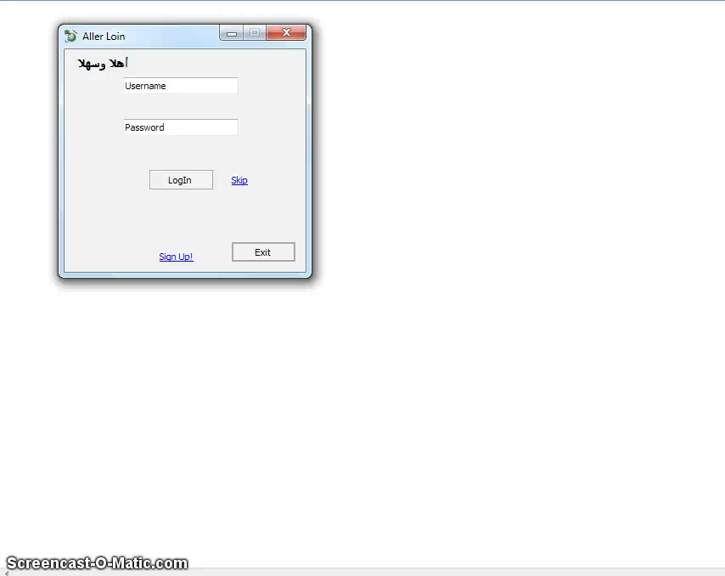
5. Tutorial:

Slide 18

6. Design
This section discusses about the design of our application, laying out the forms/pages, and dissecting every little detail about every page.
This is the icon of “Aller Loin”:

Slide 19
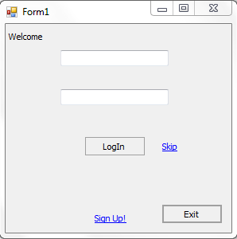
6.1 Welcome Screen:
In this page you can sign in, register or simply skip it and go to the main.

Slide 20
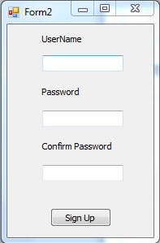
6.2 Sign up:
In this page the user can create an account by entering his/her username and password.

Slide 21
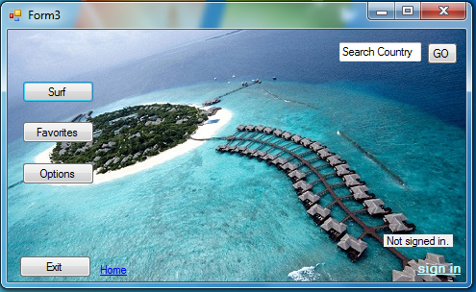
6.3 Main Screen:
In this page the user can choose between surf, favorites, options, search and sign in.

Slide 22
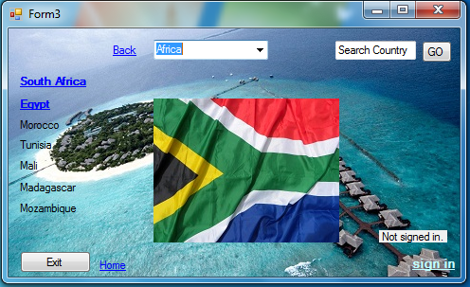
6.3.1 List of countries:
This form contains a list of countries of each continent.

Slide 23
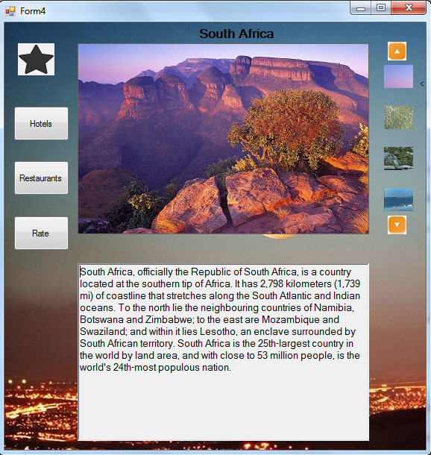
6.4 Country Description:
This is the page where the user takes all of the information about the selected country.

Slide 24
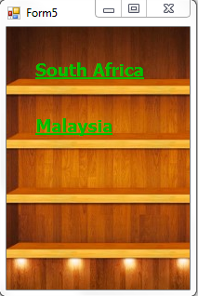
6.5 Favorites:
In this form the user can see a list of country that he/she added them to his/her favorites.

Slide 25
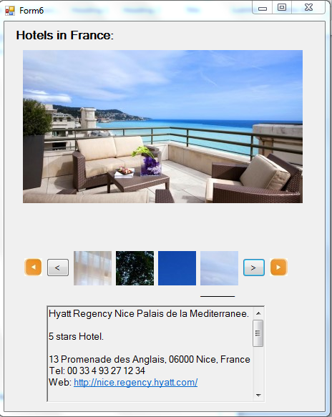
6.6 Hotels/Restaurants:
In this section Hotels, Restaurants are listed (each in different pages).
With a small description about each hotel, restaurant and attraction.

Slide 26
7. Future Work:
In the future, we’ll make sure that we update the application and make it contain details about every touristic country around the world, and in every country we will put more details including more hotels, restaurants and pictures.
And we will try to improve the interface and make it beautiful and enjoyable.

Slide 27
8. Conclusion:
In conclusion, this application taught us a lot about how design is an important part of programming and at the same time, we learned knew stuff on our own.
Further adjustments and enhancements will happen to aller loin.

